Slide 1



Session 3: On-page Optimization

Slide 2
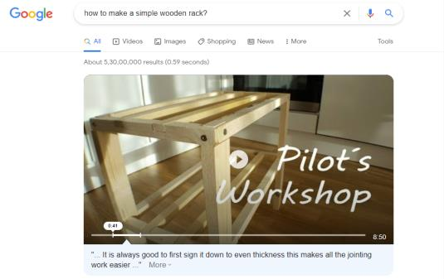

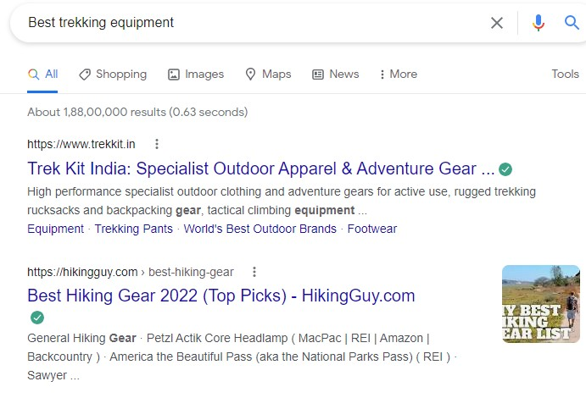
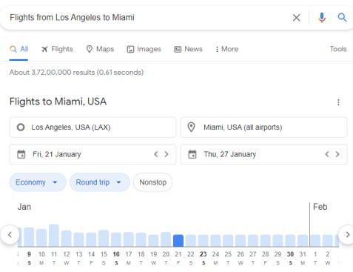
On- page Optimization
On-page optimization:
Optimizes individual Web pages
Uses quality content and efficient HTML source code
Helps search engines understand the Website and achieve ranking
Includes analysis and regular monitoring
Informational
Navigational
Commercial
Transactional

Slide 3
Techniques for On-page Optimization 1-2
Page Titles
Meta Descriptions
Headers
Optimize HTML Tags
Good Internal Linking structure and credible external links
Content Formatting Guidelines: Font and Colors, Heading, Bullet Points, Paragraph, Media
Informative and well-structured URLs
Image Guidelines: Long-form Content, Image Sitemap, Alternative Text, Compress Images

Slide 4
Techniques for On-page Optimization 2-2
Improve Page Experience
Include Sitemaps
Perform Content Audit
Allow Comment on Blog Posts
Understand Search Intent
Mobile Friendliness
Secure Connection

Slide 5

What are Keywords and their
Importance?
Words or phrases that people search for using search engines
Keywords
Select keywords
wisely
Use keywords with two or three words
Group keywords into themes

Slide 6
Keyword Research and its Process 1-2
Ensure the Web content matches with the search intent of the audience
Make a list of keywords
for these topics
Rank the topics based on their importance
Make a list of important topics related to the Website
Have a good knowledge
about the industry

Slide 7
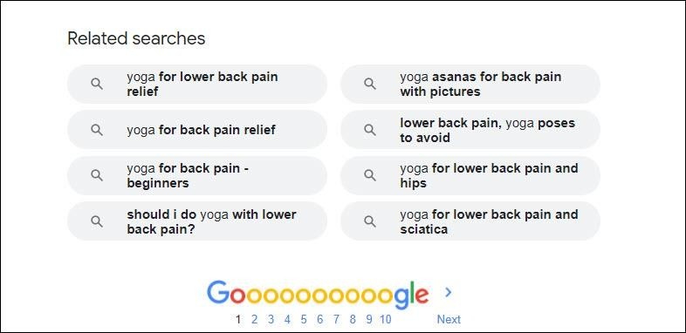
Keyword Research and its Process 2-2
Use keyword research tools, such as Google’s Keyword Planner, Ahrefs, and SEMrush for help on
keywords
Check out ‘related searches’ at the bottom of the Google search result page to consider more
keywords

Slide 8
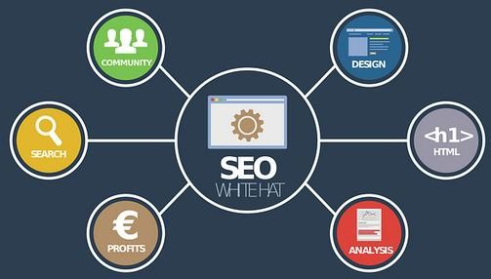
Role of Content in On-page Optimization
Key Benefits:
Backlinks
High Click- Through Rate

Slide 9
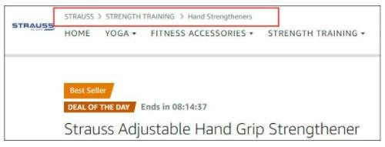
Site Structure and Website Navigation
Is the process of determining the hierarchy of information on Website
Influences how the page ranks in search results
Site structure
Is the process of directing traffic to the appropriate page on a Website
Optimizes the accessibility of the site's content
Website Navigation

Slide 10


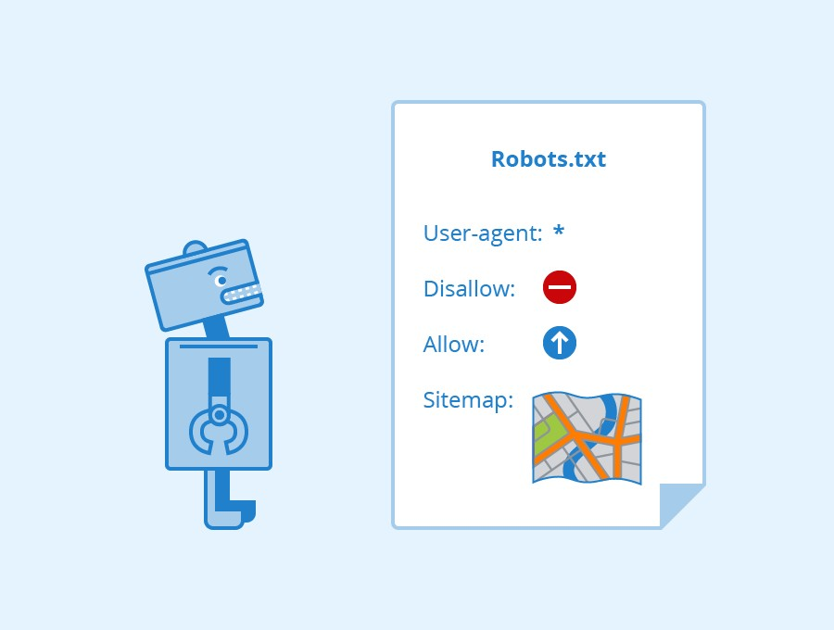

Importance of robots.txt File

